Slide 1
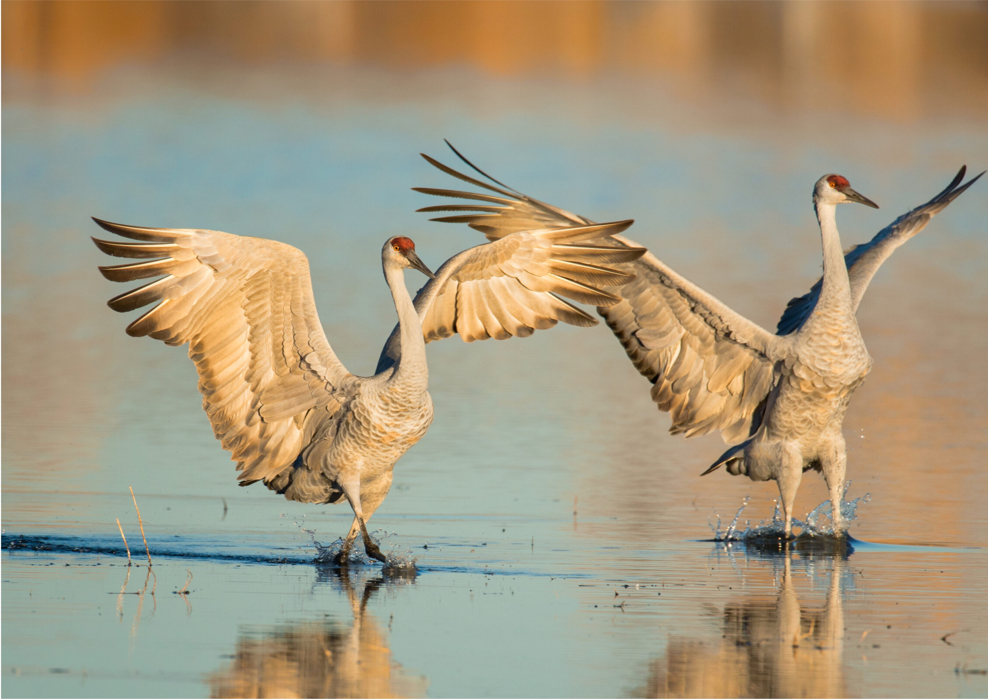

The Cranes are Coming Back to Kearney!

Slide 2
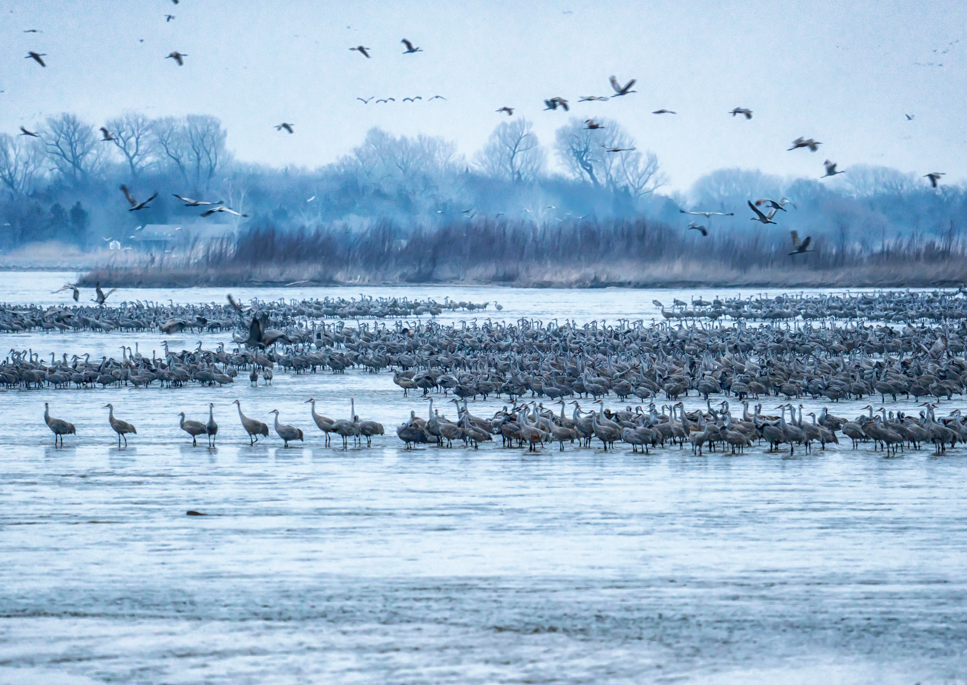

OPPORTUNITY AWAITS!
Every Spring, Kearney Becomes the Center of Attention
Each year, nearly 800,000 Sandhill Cranes migrate through Central Nebraska, attracting thousands of visitors from across the country and around the world.
The Annual Crane Migration generates millions of tourism dollars for Kearney area businesses including restaurants, hotels, retail shops, and attractions.

Slide 3
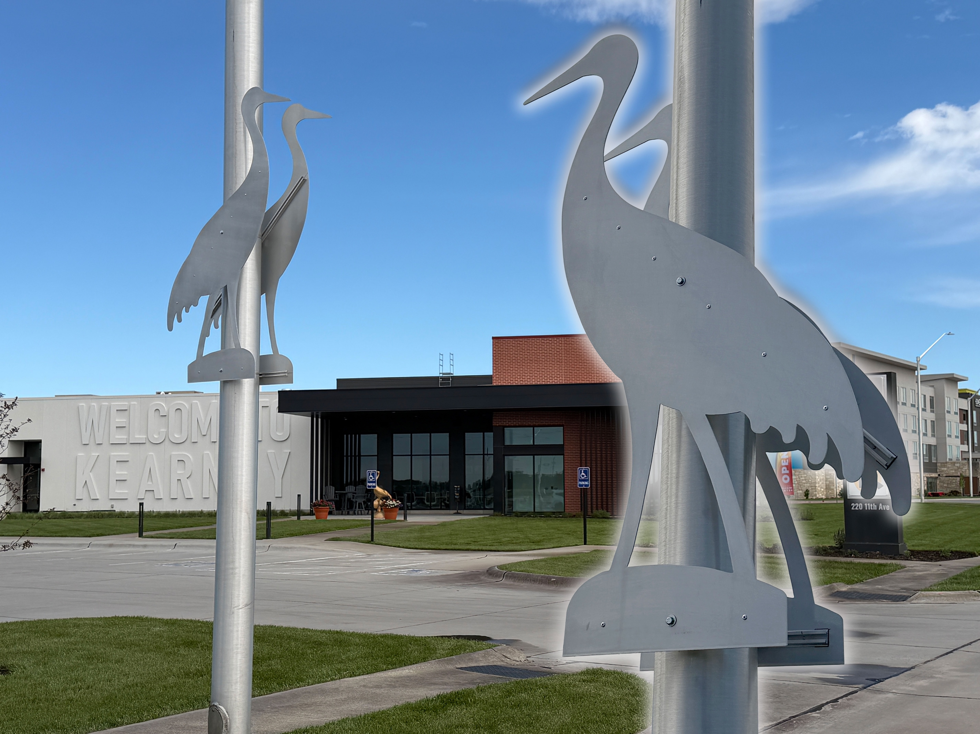
What if Kearney Could Celebrate the Cranes Year-Round?
Cranes on Parade 4 transforms one of Nebraska’s most celebrated natural events into a lasting public art experience.
Custom-designed aluminum crane sculptures will be displayed throughout Kearney’s business districts—creating beauty, visibility, conversation, and community pride.

Slide 4
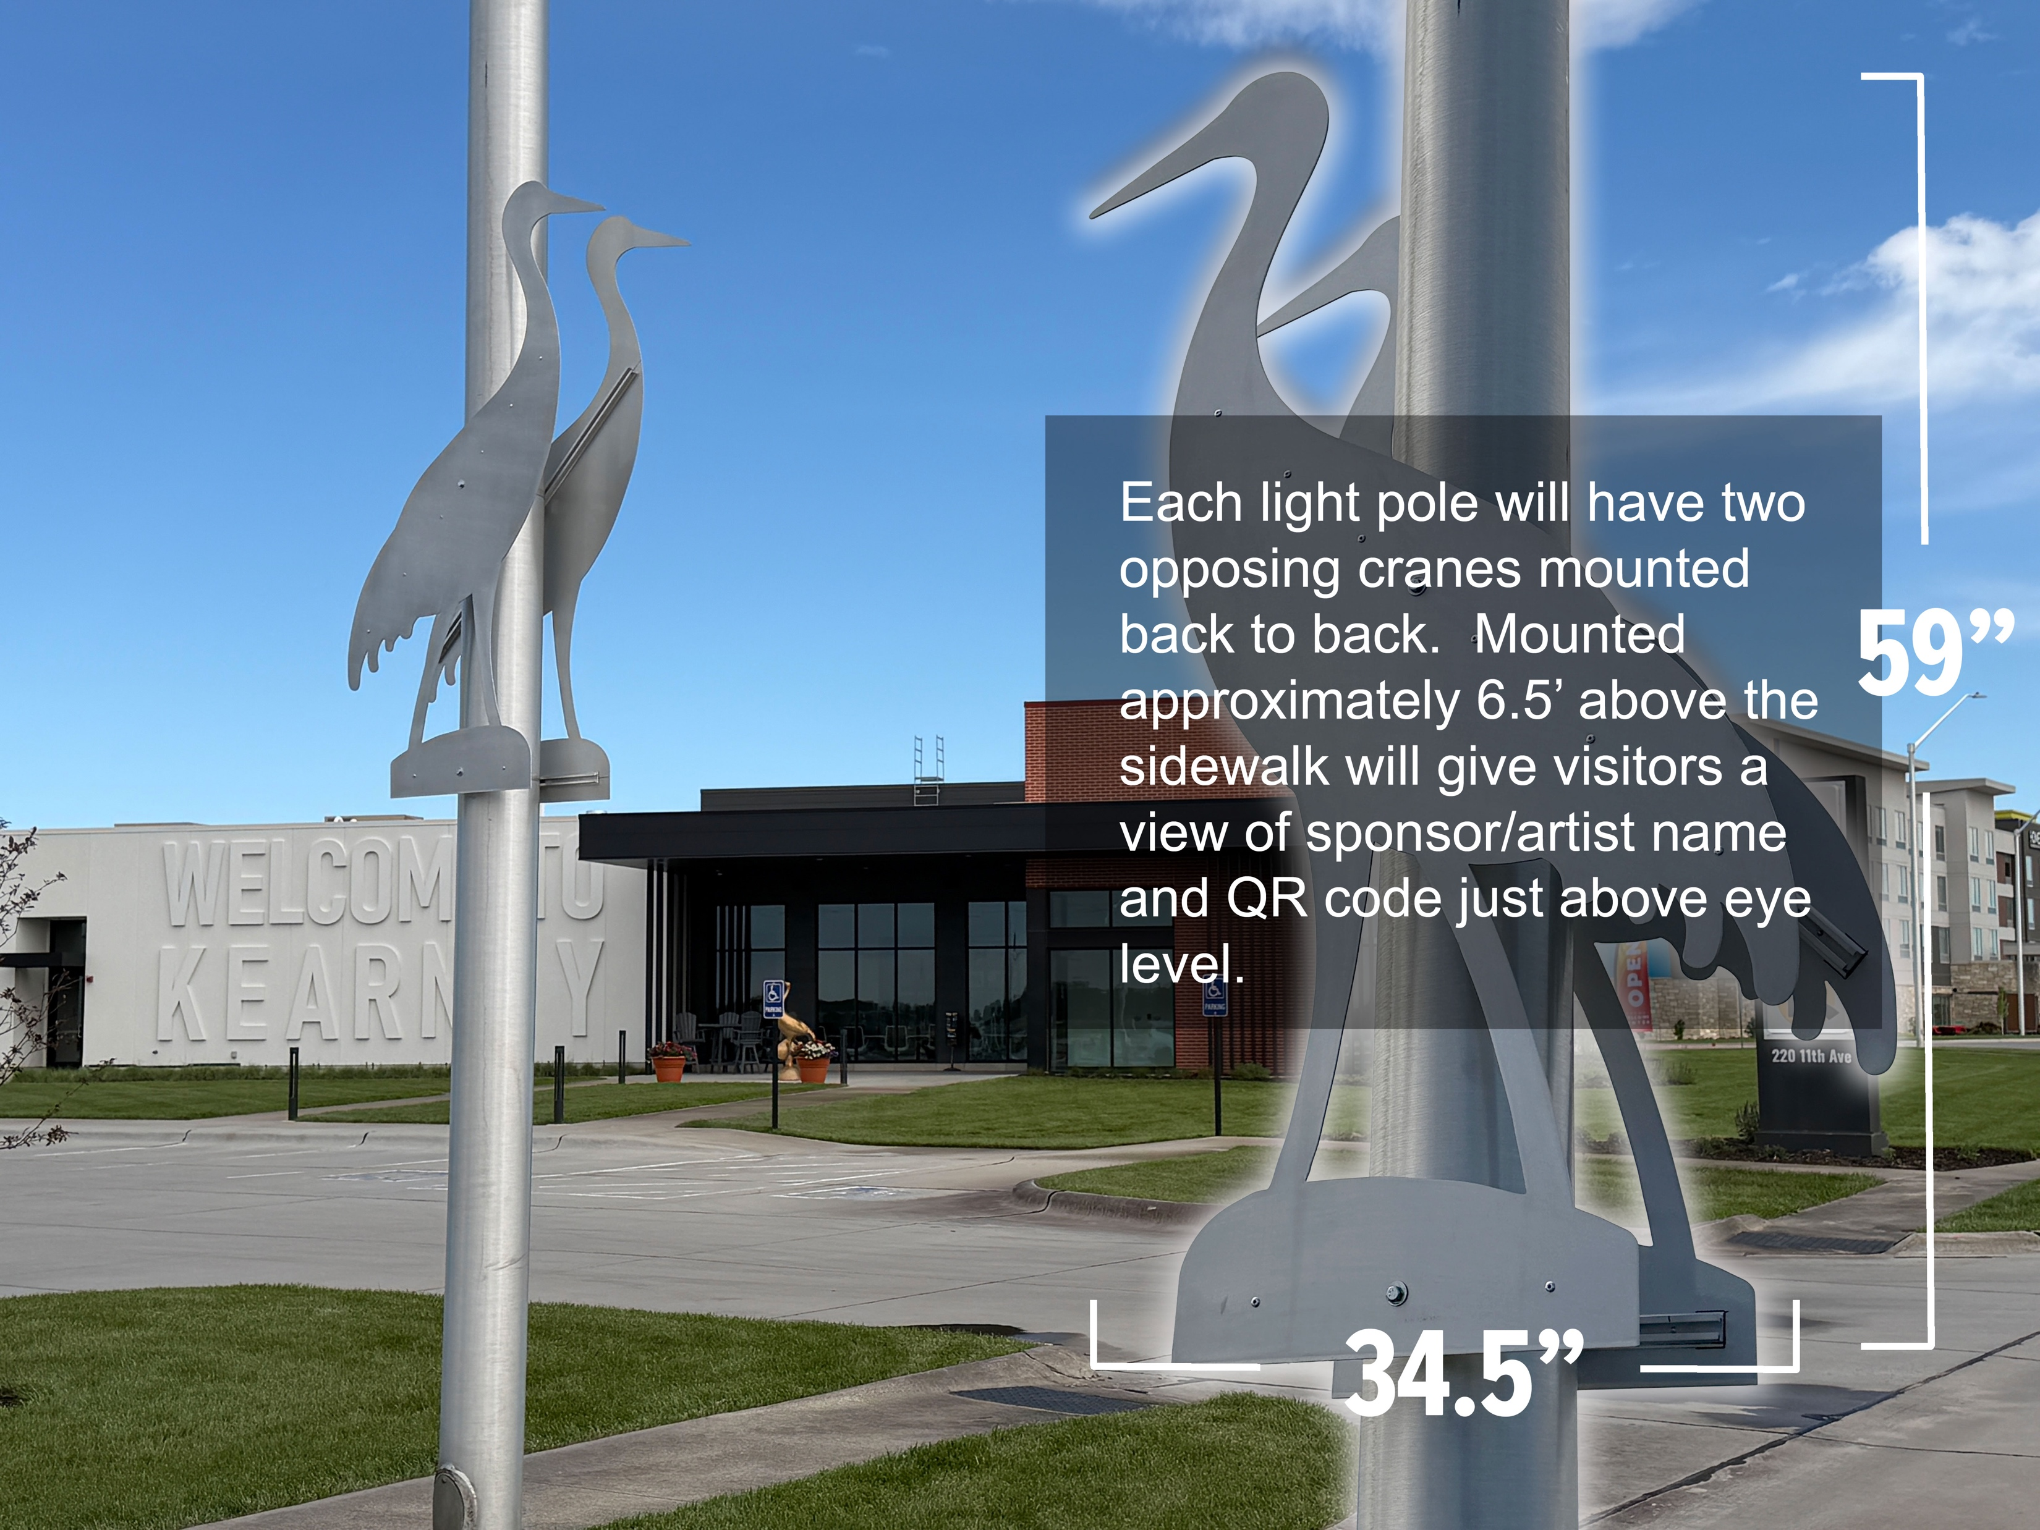
Your Business.
Your Crane.
Your Visibility.
Each light pole installation features:
Two opposing cranes mounted back-to-back
Sponsor recognition plaque
QR code integration
Highly visible Kearney placement

Slide 5
The Concept
59” x 34.5” Laser-cut Aluminum Crane
Two Cranes Mounted Back-to-Back
Select Artist’s Designed, Painted
Select Prominent Business District Locations
Clear Coated for long-term Outdoor Display
Installed approximately 6.5’ above Sidewalk
QR Code linked to Business page on CranesOnParade.com

Slide 6
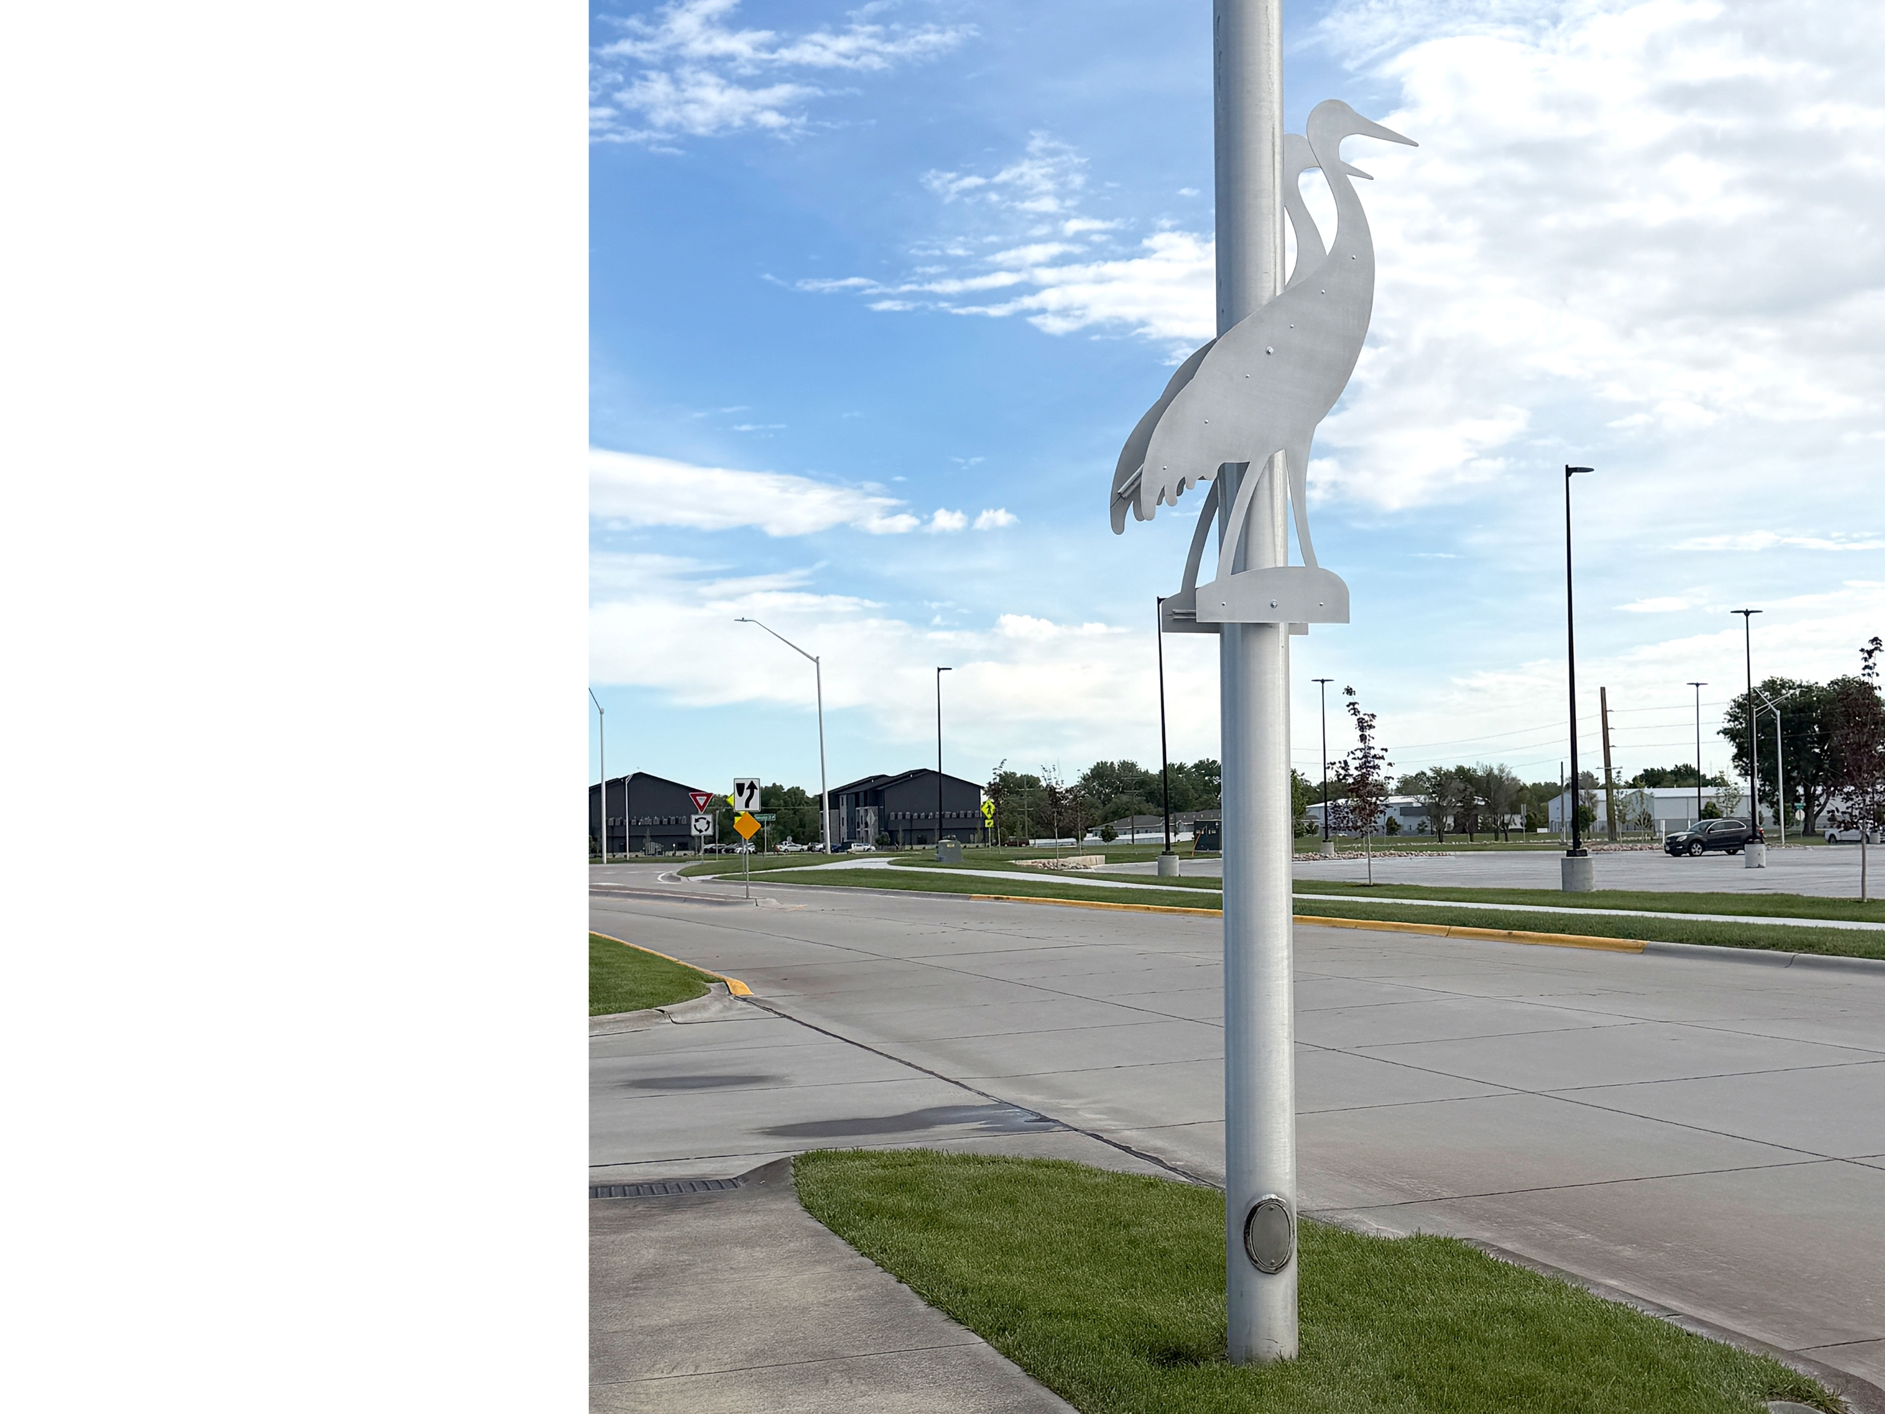
HIGH VISIBILITY
Why Businesses are Getting Excited
1
2
YEAR-ROUND EXPOSURE
Installed directly in high-traffic business areas
A long-term Permanent installation—not a temporary advertisement
3
4
SOCIAL ENGAGEMENT
COMMUNITY LEADERSHIP
Photo-worthy installations encouraging sharing & interactions
Align your business with Art, Culture & Community Investment

Slide 7
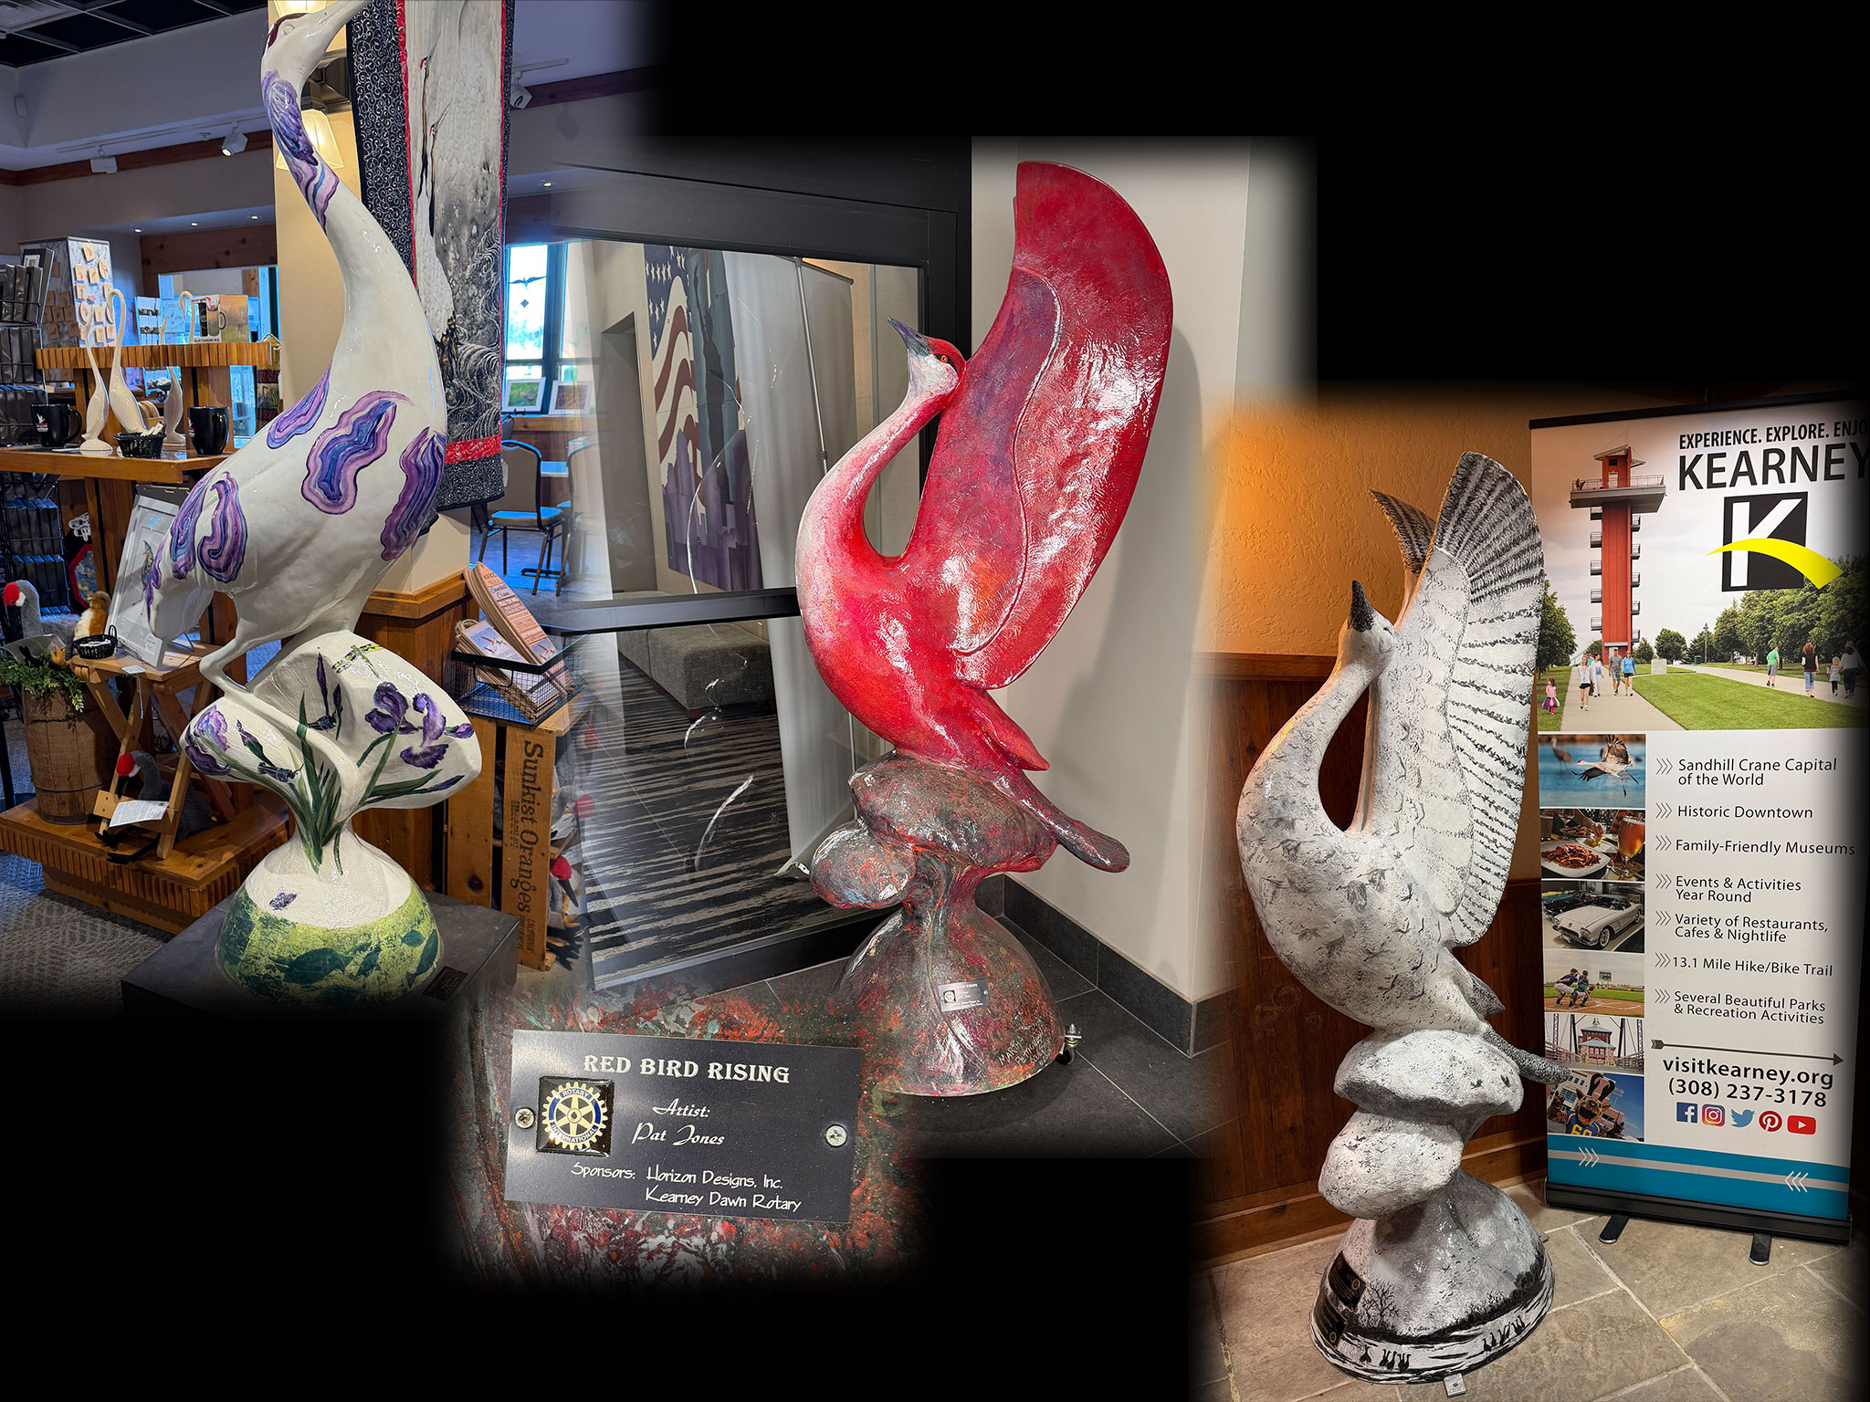
Visible 24/7 • Every
Season • Every Year
Not a 30-Day
Campaign … but a
Multi-Year Landmark
Unlike traditional advertising, Cranes on Parade installations remain visible for years—creating ongoing recognition for sponsors and continued enjoyment for residents and visitors.

Slide 8
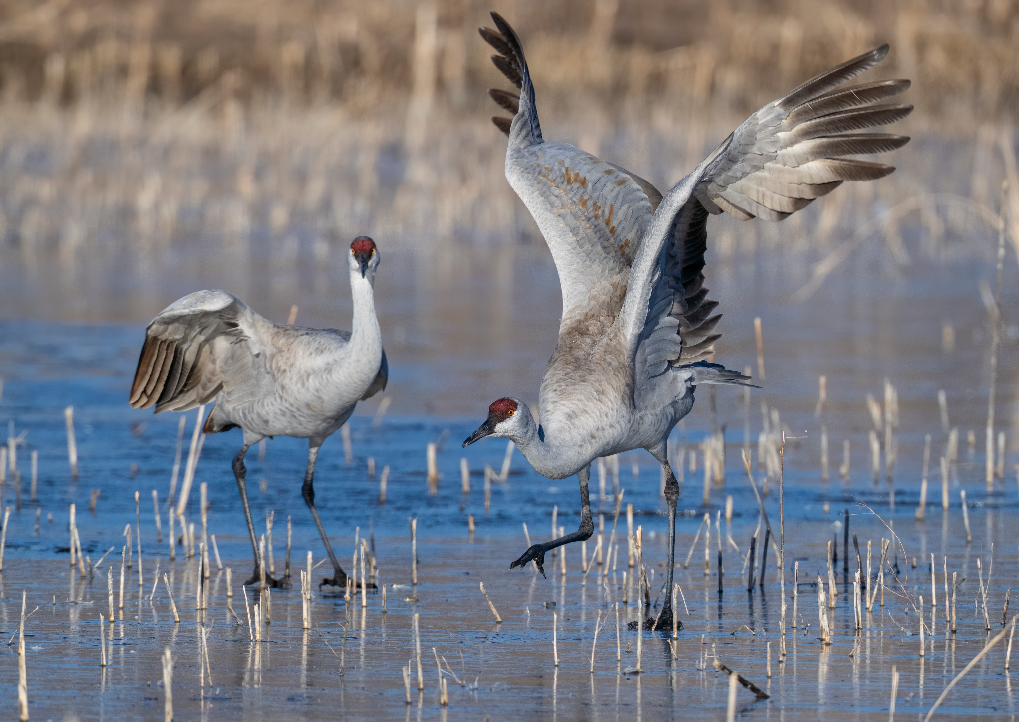
Thousands of Visitors
Millions in Economic Impact
Be a Part of the
Visitor Experience
Visitors already travel to Kearney to experience the Sandhill Crane Migration.
Cranes on Parade extends that experience into downtown shopping districts, restaurants, hotels, and community spaces—encouraging exploration throughout the city.

Slide 9
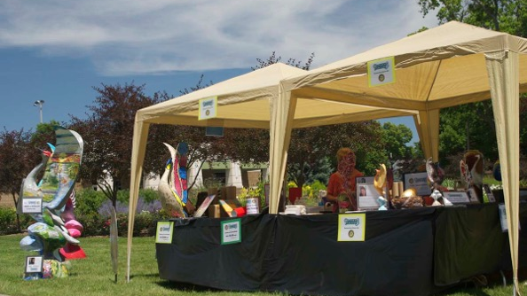
Public Exposure
Local Artists. Local
Creativity. Local Pride.
Each crane installation will be uniquely decorated by selected artists, creating one-of-a-kind pieces that reflect creativity, culture, and the spirit of Nebraska.
Artists gain:
Portfolio Recognition
Community Engagement Opportunities

Slide 10
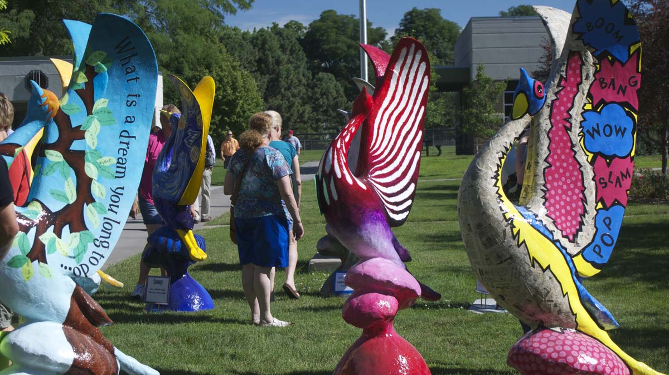
Building on a
Successful Tradition
Previous Cranes on Parade projects brought together:
Artists
Sponsors
Community organizations
Rotary volunteers
The result was a memorable public art experience that generated excitement, visibility, and meaningful community impact.

Slide 11
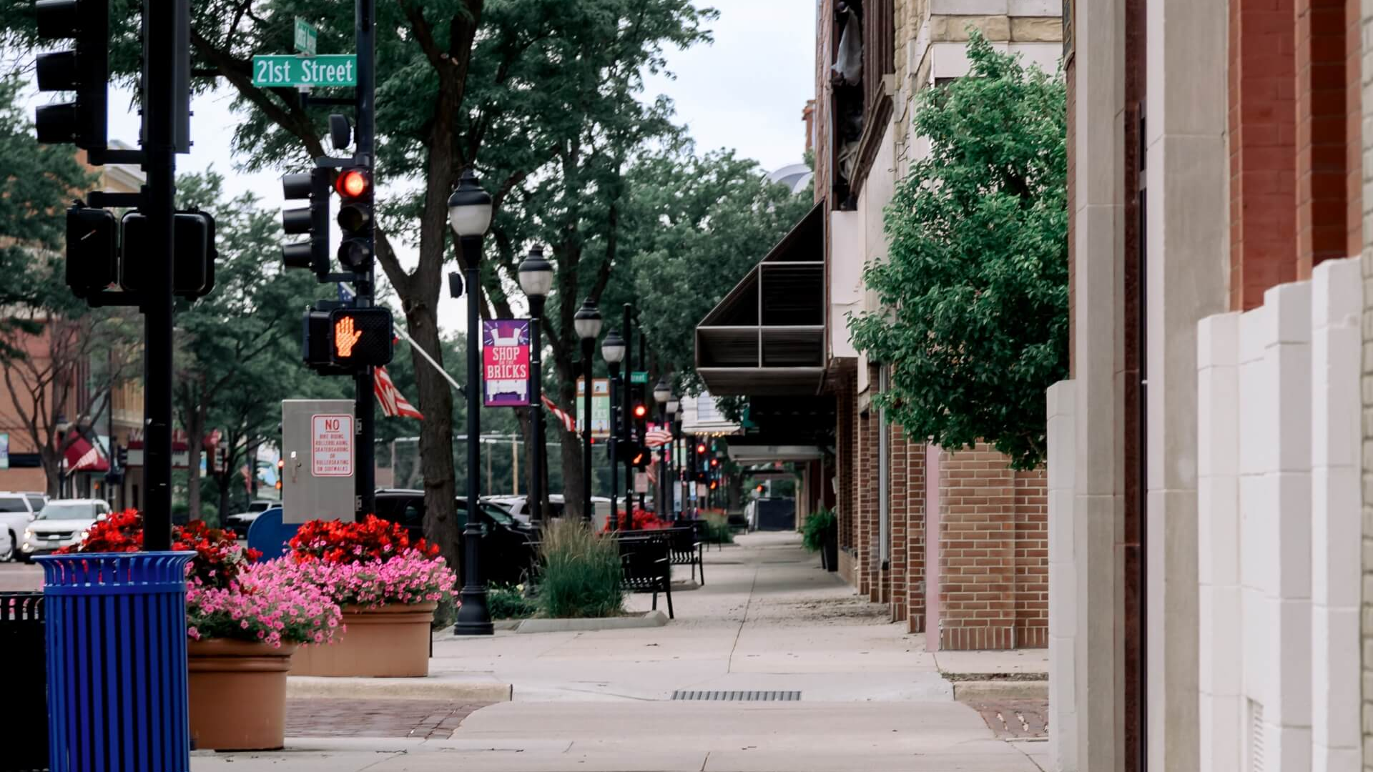
Art with a Purpose
Supporting Meaningful Community Projects
Cranes on Parade 4
Beneficiaries will be:
Funds raised through previous Cranes on Parade projects have supported numerous local and international initiatives, including:
The Safe Center
Family Advocacy Network
The Kearney Area Children’s Museum
Kearney Community Sustainable Housing
Press on Ministries
Safe Center
KACF
MONA
Water for Haiti
Rotary Polio Plus
Rotary RotoPlast
Rotary Children of the Dump
The ARC of Buffalo County
Rowe Sanctuary
Kearney Children’s Museum
Himanchal Foundation
The Nature Conservancy
CASA of Buffalo County
… and MANY more

Slide 12
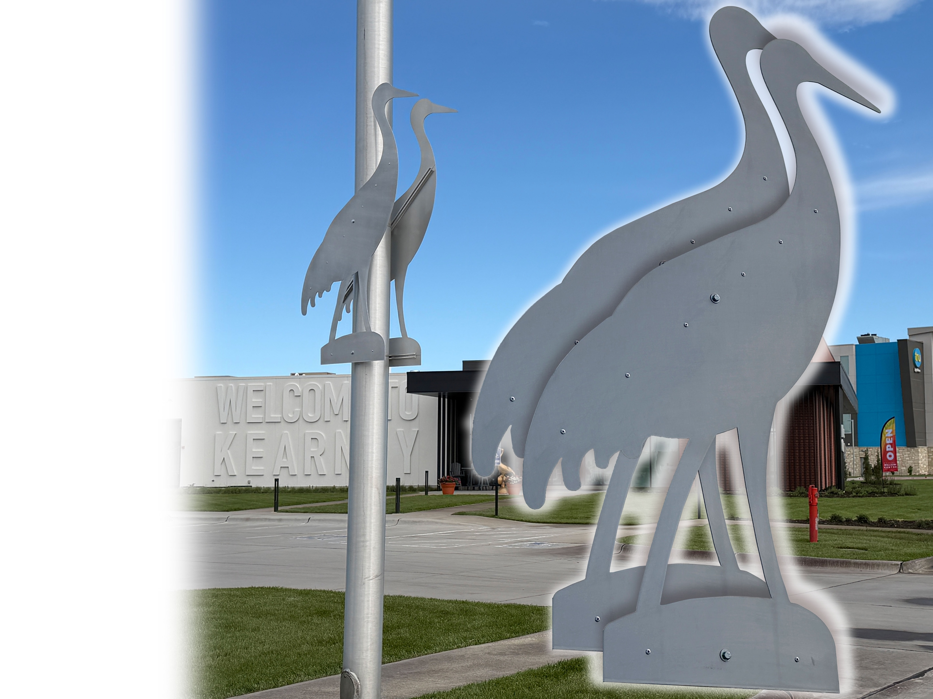
Your Lasting Investment in Public Art for the Kearney Community
Sponsorship Opportunity
$2,500
One PAIR of opposing Aluminum Cranes
Committee will assist in determining placement
Sponsor Recognition Plaque
QR Code linked to CranesOnParade.com
Promotion of YOUR Business on ALL Promotional Materials, Posters, & Maps
… Additional Public Opportunities

Slide 13
Your Lasting Investment in Public Art for the Kearney Community
Sponsorship Benefits
Partner with signature Kearney Project
Community Recognition
Highly Visible Community Locations
Crane Migration Tourism Exposure
Long-Term Cranes on Parade Visibility
Social Media Recognition Opportunities
… Additional Public Appearances

Slide 14
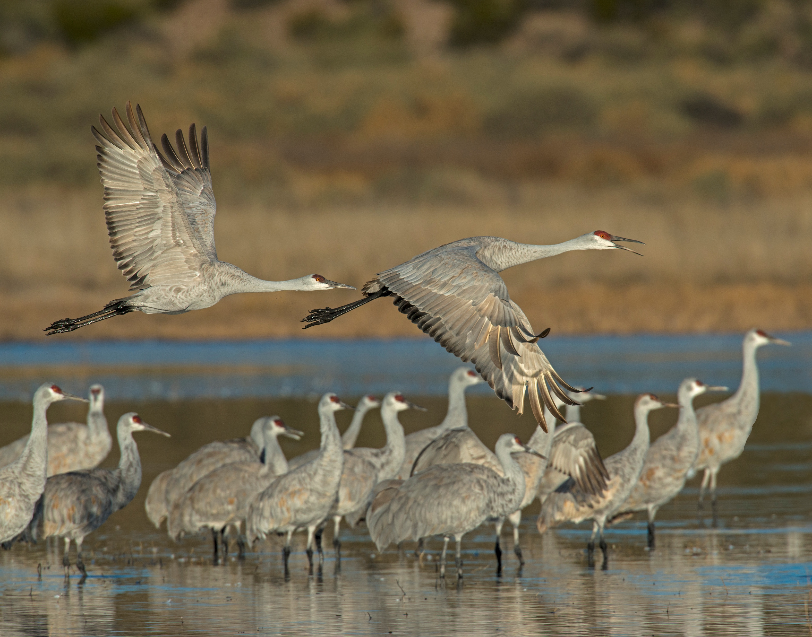
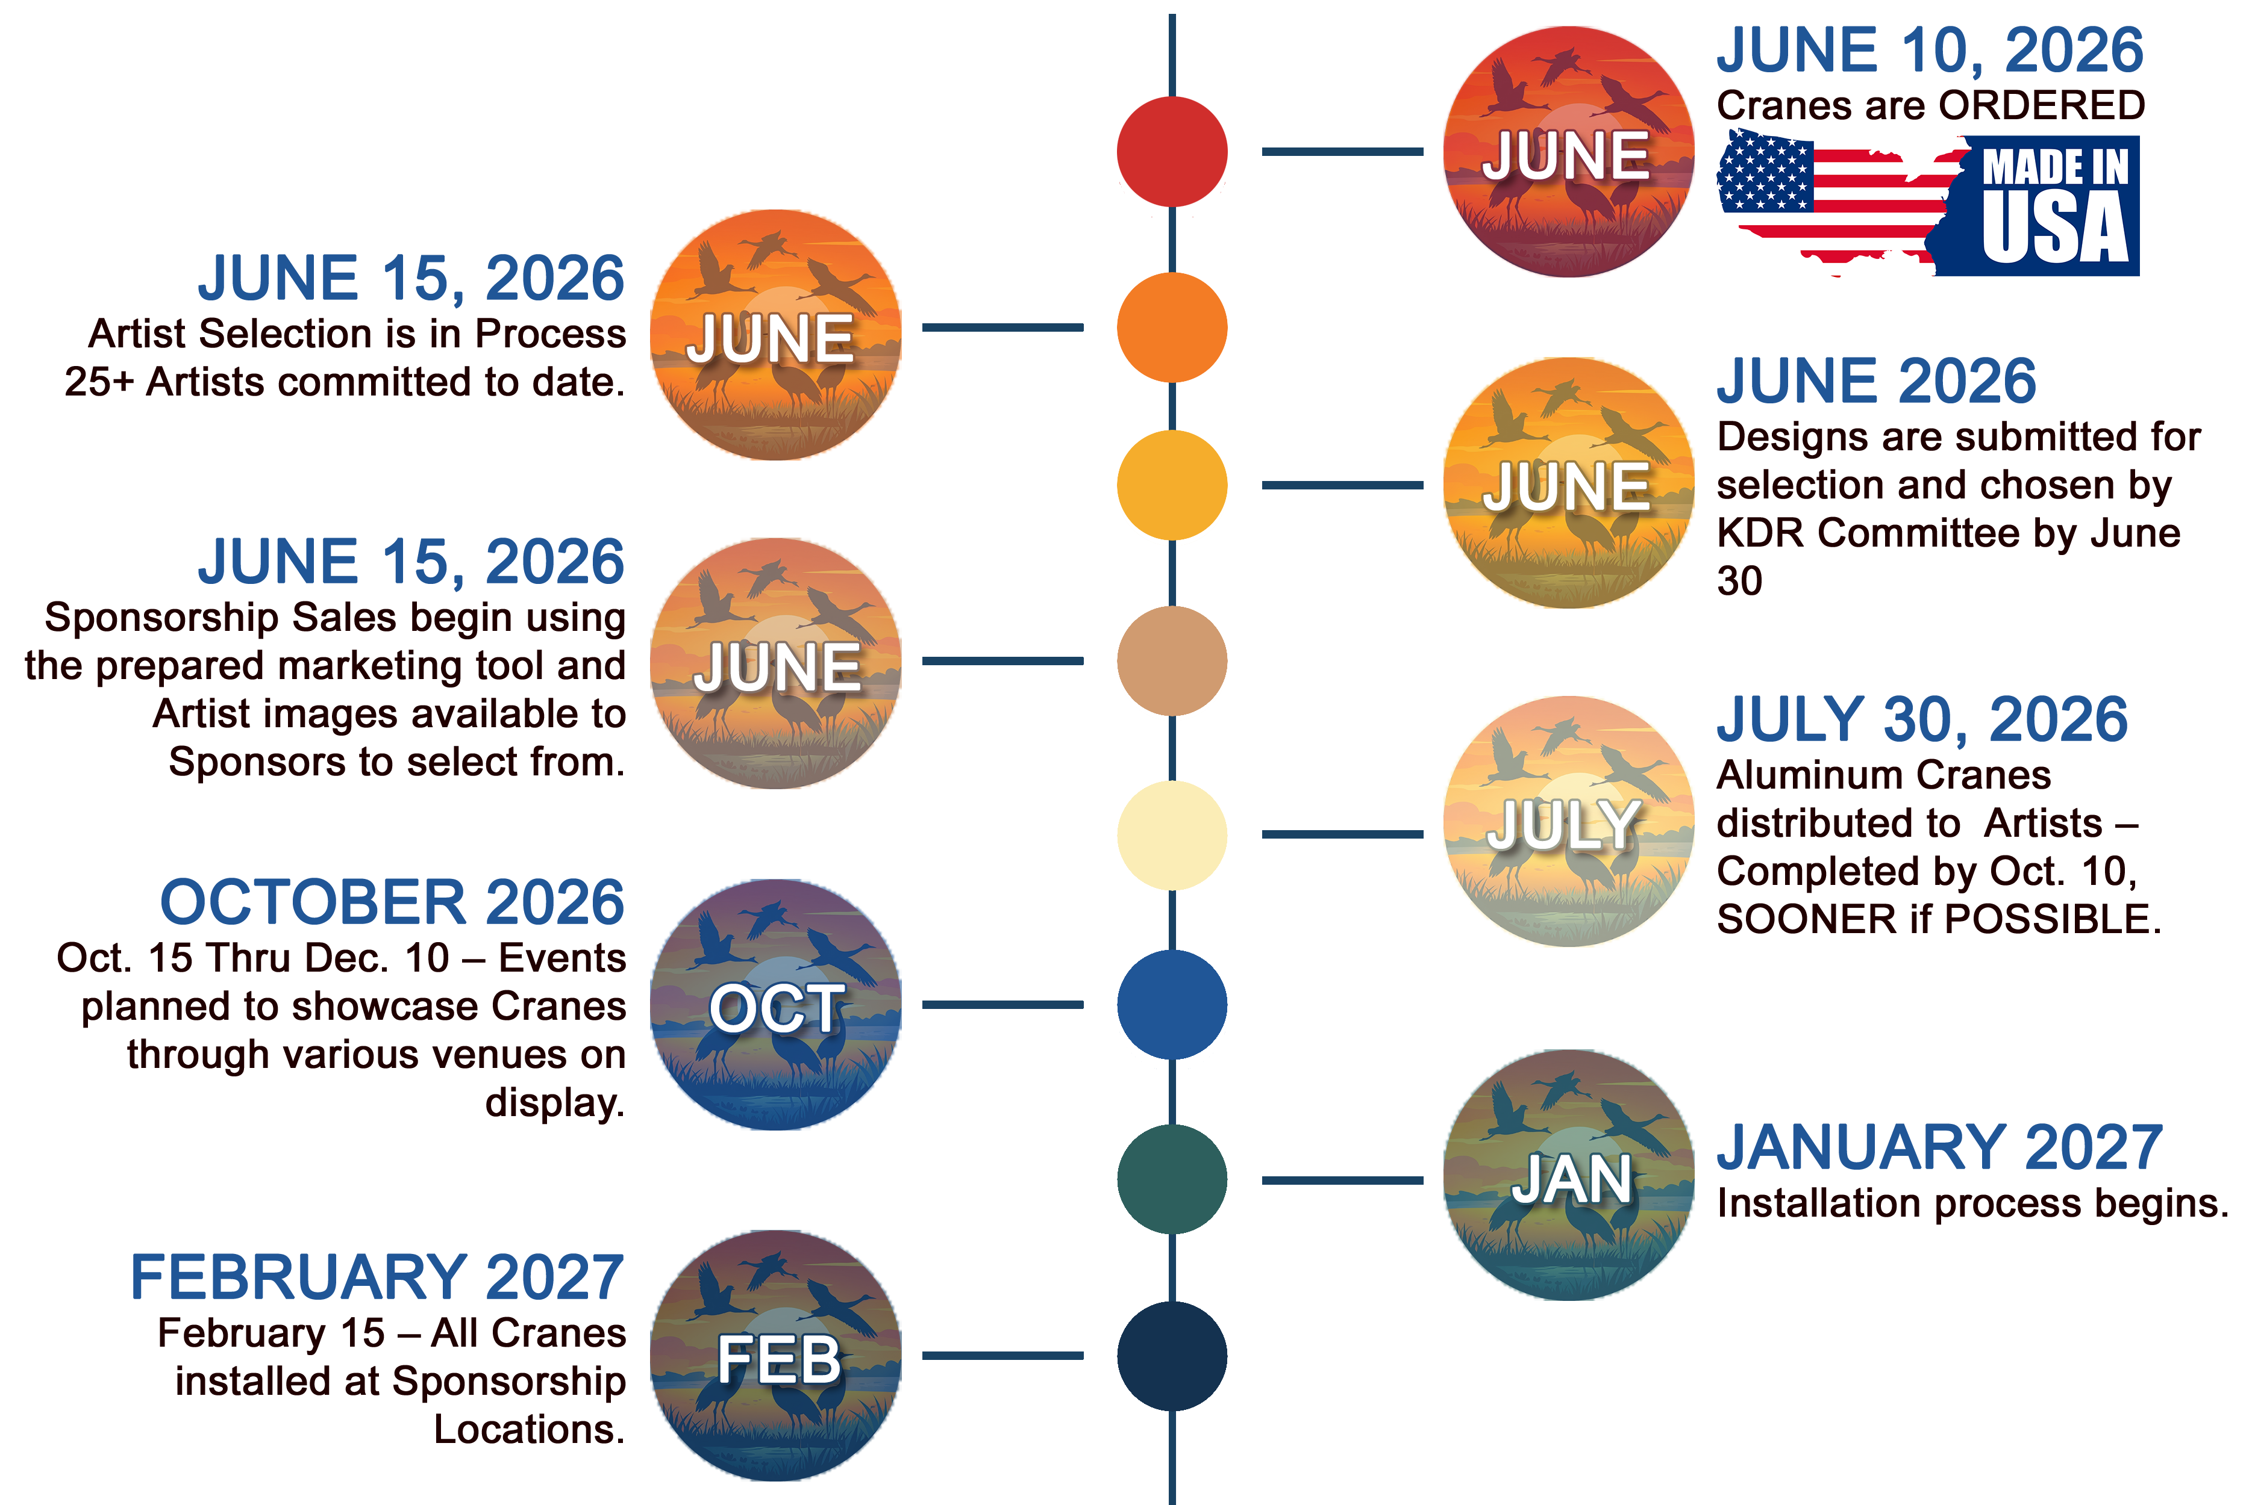
Project Timeline

Slide 15
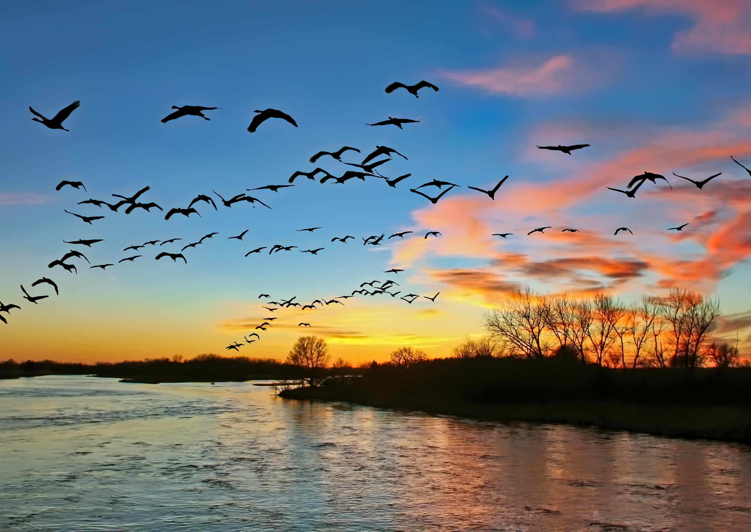
Contact Information
Tom Murphy
(308) 530-4483 sponsors@CranesonParade.com
Reserve Your
Crane Pair Today
Join Kearney Dawn Rotary Club in creating a lasting public art experience that celebrates our community, supports local artists, and welcomes visitors for years to come.

Slide 16
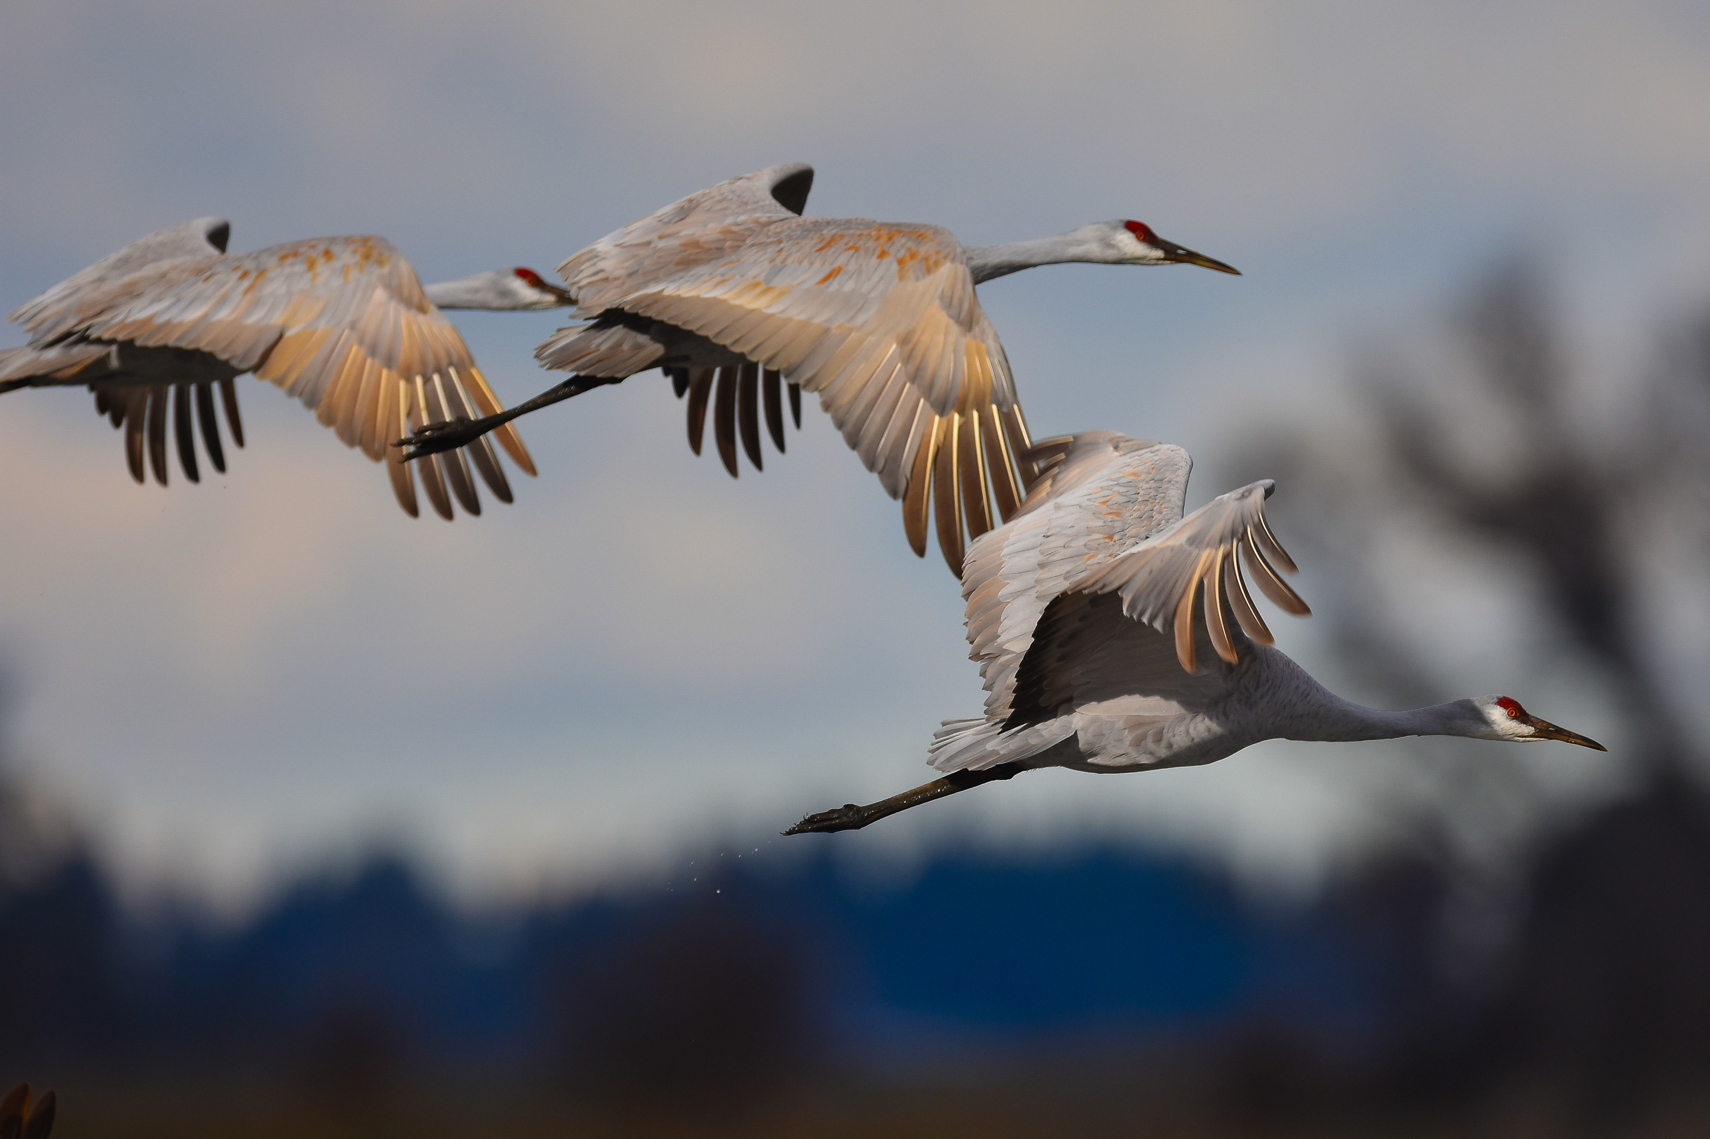


• Celebrating Art
• Causes • Community
• Crane Migration
Are you All in?

